Slide 1

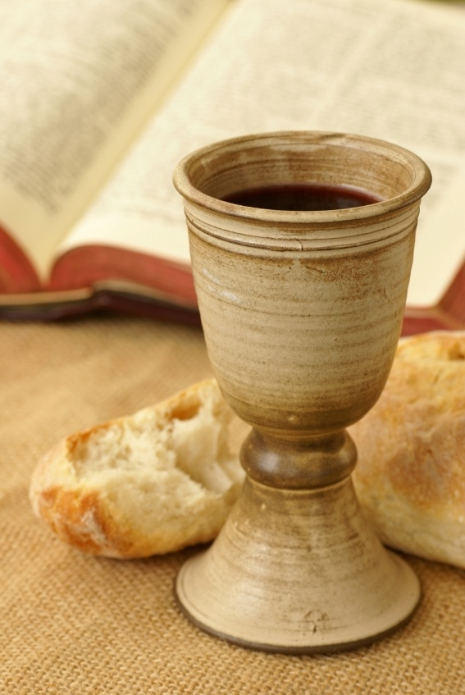
“Do this in remembrance of Me.”
- 1 Cor. 11:26

Slide 2

“Do this in remembrance of Me.”
“The truth that is a memorial has been perverted into a sacrament. Because the unregenerate mind does not appreciate the cross work of Christ, the Lord’s Supper may be appended to a preaching service and given little emphasis. The goal is a plea to be made for the reverent participation of the saints as they function as priests in worshiping.”
- Don Norbie

Slide 3
“Throughout the history of the church, whenever the church, whenever the church was experiencing spiritual revival, the Lord’s Supper was especially vibrant and alive.”
-David Dunlap

Slide 4
“He gave thanks. We ought also to give thanks. But it is well for us, that in this, as in everything else, He intercedes for us, and covers our guilt with His death, and our deficiencies with His fullness.”
-F.W. Krummacher

Slide 5
“When we come together for the Lord’s Supper, Christ is as truly present in our midst as He was among the first disciples two thousand years ago.”
-H.A.Ironside

Slide 6
“The death of Christ is the weightiest article of the Christian faith. Christ died for our sins according to the Scriptures. We cannot think of that death too often.”
-Charles H. Spurgeon

Slide 7
“Do this in remembrance of Me.”
-Jesus

Slide 8
“Do this in remembrance of Me.”
Seven questions:
Why is it so important?
What is its purpose?
Who should participate?
What is appropriate?
How simple is it?
How frequent is it?
Who is it for?

Slide 9
“Do this in remembrance of Me.”
Outline:
Its Importance
Its Purpose
Its Participants
Its Solemnity
Its Simplicity
Its Frequency
Its Fruit

Slide 10

Instituted by the Lord Himself
His dying request
A direct command
Fulfillment of the Passover feast

Slide 11

Remembrance
  Focus on Christ (Col. 1:18)
  Giving thanks as Jesus did (Matt. 26:26)
Proclaim the Lord’s death until He comes

Slide 12

Fond remembrance (1 Pet. 2:7a)
  All are not to participate! (1 Cor. 5-6)
  Unity is essential concerning Christ and fellowship is impossible to have with the unregenerate (2 Cor. 6:14, 1 Cor. 11)
No officiating Clergy

Slide 13

The privilege also brings responsibility (1 Cor. 11:27)
To be taken seriously
Preparation is wise and Biblical (Ps. 96:9)

Slide 14

The Lord: (1 Corinthians 11:23-34, Luke 22:7-23)
Simple command
Simple instructions
Simple example
You:
Simple obedience?

Slide 15

How much is too much?
How much is not enough?
Should be often enough to keep our hearts from growing distant or cold.
Although no specific command is given as to its frequency, the example set in the Acts is on the first day of each week (Acts 20:7)

Slide 16

Puts the heart in the best place (2 Cor. 8:5)
Foretaste of heaven (Rev. 22:3-5)
Looks forward to His coming (1 Cor. 11:26)
“For as often as you eat this bread, and drink this cup, you proclaim the Lord’s death, until He comes.” -1 Cor. 11:26

